Slide 1

ADNI PET CORE
Susan Landau Andy Horng
Suzanne Baker Bob Koeppe
Eric Reiman Kewei Chen
Chet Mathis
Julie Price
World Wide
ADNI Update
July 22, 2016

Slide 2
ADNI FDG scan counts
Number of FDG scans | N | SMC | EMCI | LMCI | AD | Total
1 | 343 | 106 | 306 | 409 | 241 | 1408
2 | 258 |  | 167 | 279 | 112 | 816
3 | 92 |  | 1 | 181 | 75 | 349
4 | 85 |  |  | 162 | 58 | 305
5 | 72 |  |  | 146 |  | 218
6 | 39 |  |  | 105 |  | 144
7 | 25 |  |  | 56 |  | 81
8 | 5 |  |  | 28 |  | 33
9 |  |  |  | 5 |  | 5
Total | 919 | 106 | 474 | 1371 | 486 | 3359

Slide 3
ADNI Florbetapir scan counts
Number of Florbetapir scans | N | SMC | EMCI | LMCI | AD | Total
1 | 264 | 104 | 303 | 224 | 193 | 1089
2 | 210 | 74 | 218 | 150 | 49 | 701
3 | 93 | 0 | 94 | 49 | 5 | 241
Total | 567 | 178 | 615 | 423 | 247 | 2031
ADNI AV1451 scan counts
Number of AV1451 scans | N | SMC | EMCI | LMCI | AD | Total
1 | 19 | 8 | 12 | 17 | 5 | 61

Slide 4
Baseline Florbetapir Distribution
31% are Florbetapir+
Normal
N= 264
36% are Florbetapir+
SMC
N=104
48% are Florbetapir+
EMCI
N=303
Frequency
67% are Florbetapir+
LMCI
N=224
86% are Florbetapir+
AD
N=193
Baseline florbetapir cortical SUVR
Total N=1089

Slide 5
Does Baseline Florbetapir Threshold Affect Rate of Cognitive Decline?
LMCI N=177
EMCI N=257
N N=238
Annual AVLT decline
In florbetapir+ subjects only
% Florbetapir+ subjects
Baseline florbetapir positivity threshold
Baseline florbetapir positivity threshold
Rate of Decline Plateaus at ~ SUVR 1.25
Proportion of subjects positive at 1.25 = 50% (MCI), 35% (EMCI), 15% (N)
Subjects with >1.5 yr AVLT followup
Linear mixed effects models, adjusting for age, sex, education, and APOE4 status, with random intercept and slope

Slide 6
Florbetapir annual change distribution
Baseline florbetapir-
Baseline florbetapir+
61% are APOE4+
73% are APOE4+
Normal
N= 208
(27% APOE4+)
40% are APOE4+
92% are APOE4+
SMC
N= 73
(30% APOE4+)
70% are APOE4+
71% are APOE4+
EMCI
N= 218
(44% APOE4+)
Frequency
38% are APOE4+
66% are APOE4+
LMCI
N= 149
(51% APOE4+)
0% are APOE4+
66% are APOE4+
AD
N= 49
(66% APOE4+)
Annual florbetapir change (WM ref region)
Total N= 697

Slide 7
Baseline florbetapir -
>2 yr Florbetapir Trajectories
Baseline florbetapir +
78% of Florbetapir+ are Accumulators
N= 208
51% of Florbetapir- are Accumulators (15% convert to +)
76% of Florbetapir+ are Accumulators
N= 73
59% of Florbetapir- are Accumulators (20% convert to +)
71% of Florbetapir+ are Accumulators
N= 218
58% of Florbetapir- are Accumulators (15% convert to +)
67% of Florbetapir+ are Accumulators
N= 149
58% of Florbetapir- are Accumulators (11% convert to +)
68% of Florbetapir+ are Accumulators
N= 49
44% of Florbetapir- are Accumulators (0% convert to +)
Total N= 697

Slide 8
>4 yr Florbetapir Trajectories
Baseline florbetapir -
Baseline florbetapir +
91% of Florbetapir+ are Accumulators
N= 80
56% of Florbetapir- are Accumulators (17% convert to +)
77% of Florbetapir+ are Accumulators
N= 90
63% of Florbetapir- are Accumulators (23% convert to +)
76% of Florbetapir+ are Accumulators
N= 44
58% of Florbetapir- are Accumulators (5% convert to +)
33% of Florbetapir+ are Accumulators
N= 5
50% of Florbetapir- are Accumulators (0% convert to +)
Total N= 219

Slide 9
Negative normal subjects who accumulate florbetapir more likely to decline cognitively
Florbetapir
Non-accumulators
Florbetapir -
after 4 yrs
p=0.06
p=0.025
p=0.035
Episodic memory change
Episodic memory change
Florbetapir
Accumulators
Florbetapir +
after 4 yrs
Time (yrs)
relative to baseline florbetapir
Time (yrs)
relative to baseline florbetapir

Slide 10
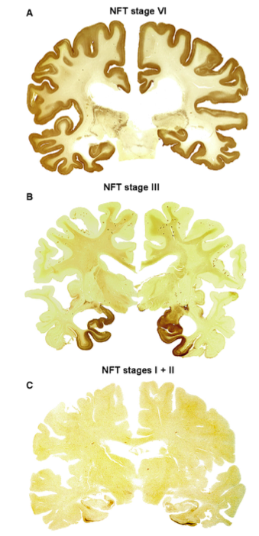
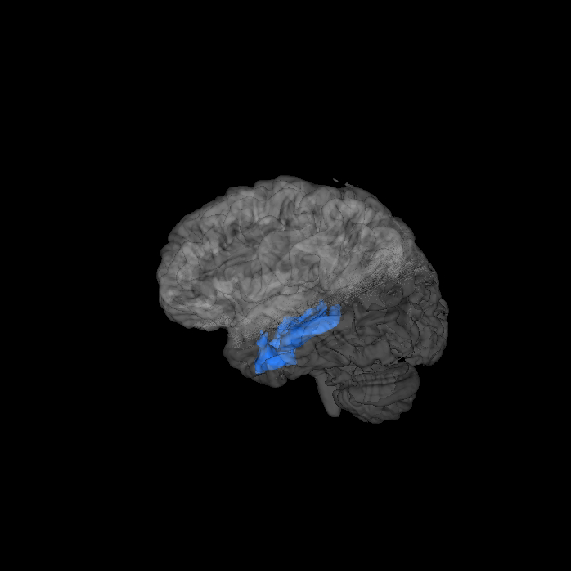
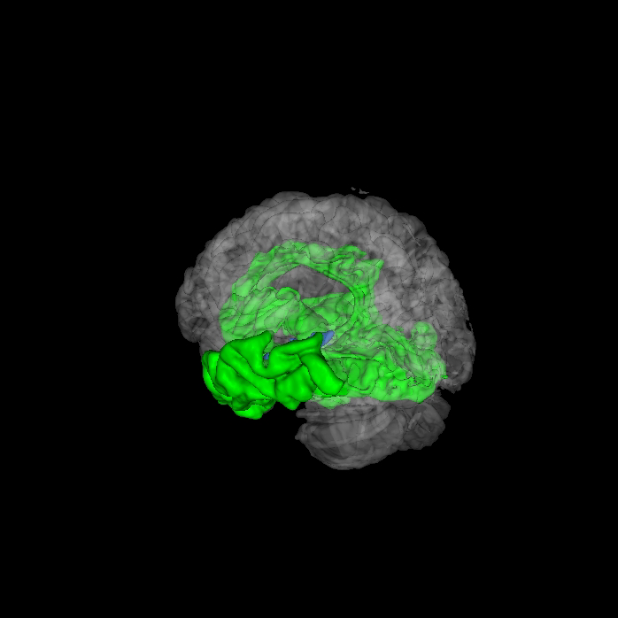
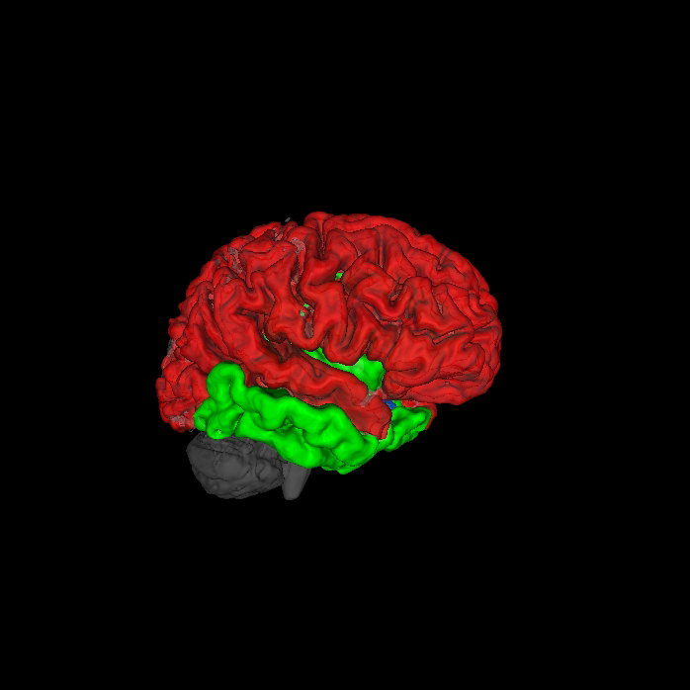
Braak staging
Braak I/II
(blue)
Braak III/IV
(green)
Braak V/VI
(red)
Notes:
Braak message:
even tho CS, suggestion is spread from MTL into limbic system into neocortex

Slide 11
AV-1451 mean images
Young Adults
N=5
PIB- Older Adults
N=17
PIB+ Older Adults
N=16
Alzheimer’s Disease
N=15
Schöll, Lockhart et al, Neuron 2016
Notes:
Figure 1. AV-1451 mean images of participant groups
Surface projections and coronal slices for young healthy adults (YA), old PiB- healthy adult (OA), old PiB+ healthy adult (OA), and AD patients are presented. Differences between cognitively healthy participants were primarily localized in inferior and lateral temporal subregions, while patient vs. control differences extended into other temporal as well as parietal and frontal cortical regions.

Slide 12
Example AV1451 scans
81yo EMCI Female
Braak1/2 = 1.18
Braak3/4= 1.17
Braak 5/6= 1.08
77yo EMCI Female
Braak1/2 = 1.32
Braak3/4= 1.18
Braak 5/6= 1.11
74yo AD Female
Braak1/2 = 2.00
Braak3/4= 1.81
Braak 5/6= 1.78
SUVR Threshold = 0.5 - 2.5

Slide 13
ADNI AV1451 summary
Baseline florbetapir -
Baseline florbetapir +

Slide 14
AV1451 tau and cognitive performance
Baseline florbetapir -
Baseline florbetapir +

Slide 15
Amyloid Imaging
Florbetapir
Florbetapir
Followup
N=700
Every 2 Years
or
or
New
(N=300)
Florbetaben
Florbetaben
Tau Imaging
80% of Amyloid Positive
20% of Amyloid Negative
[¹⁸F]AV1451
[¹⁸F]AV1451
[¹⁸F]AV1451
[¹⁸F]AV1451
All
(N=1000)
3 additional scans over 4 years
20% of Amyloid Positive
80% of Amyloid Negative
FDG Imaging
[¹⁸F]AV1451
1 additional scan at 4 years
MCI/AD
(N~650)
FDG

Slide 16
Crucial Points
We want to retain as many “rollover” subjects as possible
Projections for ~300 new subjects with florbetaben
Many sites will be scanning new subjects with florbetaben, returning subjects with florbetapir
Amyloid PET will guide tau scan frequency
Subjects randomly selected based on the 80%/20% stratification

Slide 17
A second (or third?) tau tracer in ADNI?
There has been extensive discussion amongst PPSB members, the ADNI Executive Committee, and the PET Core about adding an additional tau tracer to ADNI3
The PET Core has evaluated several tracers over the past 5 months
As of now, no additional tau tracer satisfies our requirements for both scientific rigor and availability to multiple ADNI sites at no cost

