Slide 1
Disclaimer The following summarizes some observations of a lay person on complex management issues

Slide 2
Non-Profit Corporation (NPC)
NPC Board of Directors
VA
Federal
Funding agencies
Regulators,
Auditors
NPC
Private Foundations,
Donors
Organizations
NAVREF
Industry sponsors
Investigators
Local community, Media

Slide 3
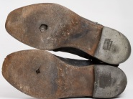
The Non-Profit Corporation (NPC):
A Flexible Funding Instrument
Donate here !
Your favorite NPC
Donate here !
All
Proceeds go to charity

Slide 4
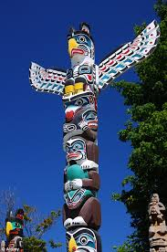
Researcher: rəˈsərCHər,ˈrēˌsərCHər/
Noun: researcher;
plural noun: researchers
a person who carries out academic or scientific research.
"a medical researcher who pioneered the development of antibiotics“
a person whose job involves discovering or verifying information book/program, etc.
"radio and TV researchers"
And, you know all about totem poles

Slide 5
MEET YOUR CLIENTALE- The researcher
Physician investigator
Basic science investigator
Study coordinators
Research Associates
Post-Doctoral Fellows
Technicians, Students
Qualification and training requirements keep growing
Opportunities and stability keep shrinking

Slide 6
MEET YOUR CLIENTALE- The researcher
Physician investigator
Automatically eligible for VA funding
mechanisms
Qualified for industry sponsored CRADAs
i.e., cooperative research and development agreement s
Clinical responsibilities + regulations= No time
<10% interested in any kind of research activity
Require support. Generally team up with basic
science investigators for laboratory research.
Expect rapid completion of CRADAs and
effective communication

Slide 7
MEET YOUR CLIENTALE- The researcher
Basic science investigator
Critical for successful basic science research
Highly vulnerable member of research team
Number restricted
Eligibility for VA funds decided by the VA
Federal funds are difficult to get (~5% success
rate)
Must get non-federal support
Increasing role as co-investigator secondary to
VA eligible investigators
Declining numbers

Slide 8
MEET YOUR CLIENTALE- The researcher
These researchers determine the success of clinical trials and research projects, develop into new investigators
Study coordinators
Research Associates
Post-Doctoral Fellows
Technicians, Students

Slide 9
MEET YOUR CLIENTALE- The researcher
Academic scientists spend about 40 percent of their time on getting research funds (2007, U.S. Government study)
Famous scientists don’t get much time for doing science
Nearly all their research time is spent on chasing grants either directly or indirectly by traveling, speaking, and schmoozing
Therefore, most complicated technical work is done by highly qualified, invisible and underpaid scientists.

Slide 10
MOST OBVIOUS SOURCES OF FUNDS
The NIH, NSF
The DOD and other federal agencies
Private foundations
Industry
Individual donors
General non-specific donations
Cause-specific donations

Slide 11
Who gets the federal research $$?
29 percent to universities
29 percent goes to industry
29 percent goes to researchers who work directly for federal agencies.
~10 percent goes to federally funded labs operated by private contractors
(The National Science Foundation)

Slide 12
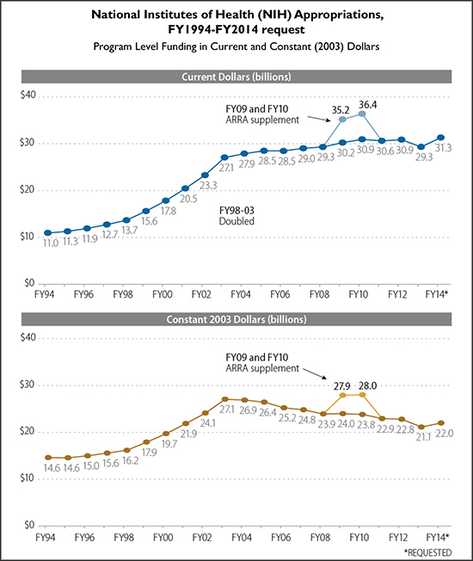
The fate of funding in constant dollar terms- Flat or down
1970: App. 2% of GDP was allocated for R&D
2014: App. 0.78% of GDP was allocated for R&D
The NIH distributed about $30 billion in 2015.
The $30 billion figure has barely risen since 2003, and has actually declined in constant dollars.
Source: Adapted by the Congressional Research Service from the NIH Budget

Slide 13
Most research centers
The govt. still funds most academic research
~80% funds are federal
~50% spent on biomed
10-20% on engineering, arts and social sciences each
Research support, if and when received, is likely to be reduced year after year.
Sometimes one is left with just over half of the requested funds. That may compromise the scientific goal of the project.

Slide 14
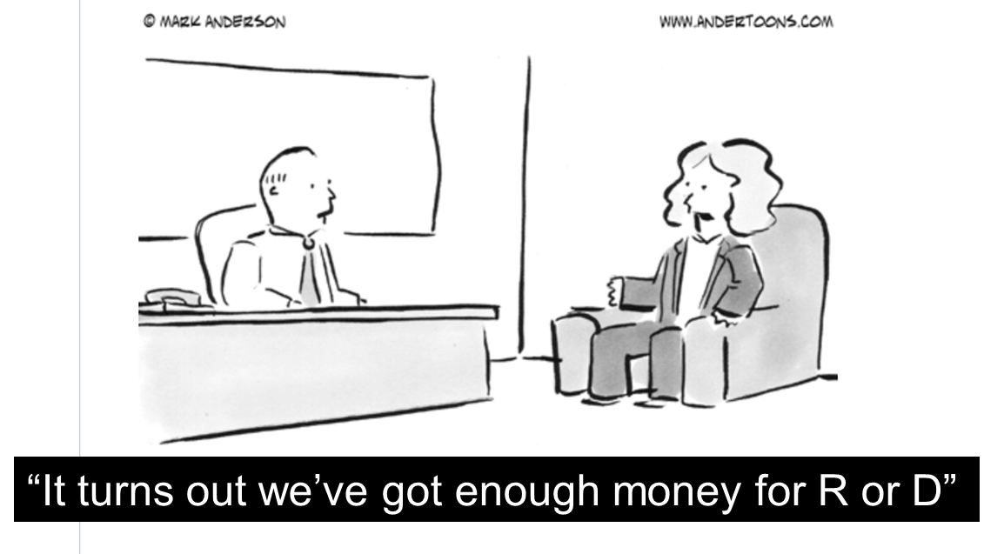
Federal and Private Funds: R or D not R&D
While govt funding stagnant, support from the industry and private foundations has increased 2-3 fold
Govt funds: 80% on research and 20% on development
Industry: 80% on development and 20% on research

Slide 15
WHAT CAN THE NPC DO
SUPPORT: Initiate programs to bring small community funds for new investigators
CONVERT: the power of 1 into 11
IDENTIFY: Investigators, board members, coordinators
ENCOURAGE: Increase exposure, interaction, communication, local meetings
NURTURE: Bring new and experienced together; Interaction among diverse expertise
CREATIVITY: Ideas to the BOD for growth, direction
EMPOWER: Investigators to approach community
SUSTAIN: Don’t lose good people, keep the pipeline flowing

Slide 16
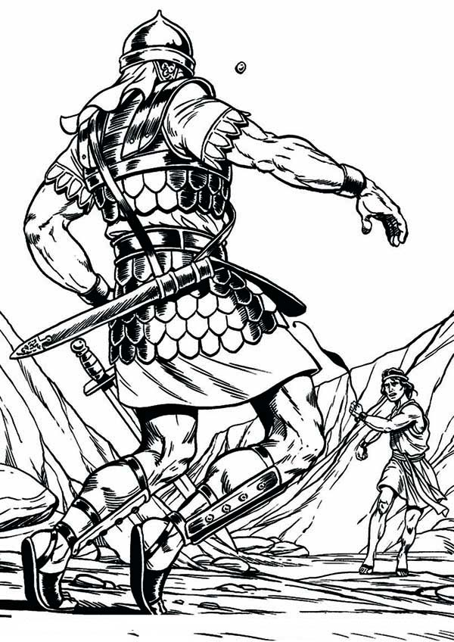
OUR EXPERIMENT
Problem:
Very few investigators. Even fewer conducting basic research
Small centers may have just one individual from a specialty
Affiliate university centers are struggling too and
may not accept application for local funds
Results: Only a few applications are submitted
Hypothesis:
David can defeat Goliath
-A MODEL WE ARE TESTING

Slide 17
Materials: Supportive leadership,
positive environment, energetic investigators
Methods:
Pool talent and skill sets
Encourage regular meetings
Share problems, information and resources
Get help from colleagues outside
Start with submitting small budget applications
Results:
Small successes
1+1= 11

Slide 18
Small NPCs and the
Boards of Directors (BOD)

Slide 19
Small NPCs and their BODs
Members are generous, high achievers, think big and wish to do good
Like all they are also creatures of habit and driven by past experience at large organizations
May lose sight of the immediate short term goals while trying to set agenda for the long term
May spend too much time administering rather than generating and acting on new ideas
May prefer planning for “big” events
May not be aware of or not interested in mundane problems of day-to-day scientific research

Slide 20
NPC Executive Director and the BOD
Communication with members of the board
Educate the BOD about your unique group
Investigator as members of the BOD are an asset. Clinical and basic science points of view
Persuade the BOD to participate while
supervising
Encourage the BOD to connect with community
Teach the BOD: small is beautiful
-Great discoveries don’t happen suddenly
-Big discoveries happen through small successes
-Research is a long term process that may lead
to new discoveries, once in a while
- Small steps now, big leaps tomorrow

Slide 22
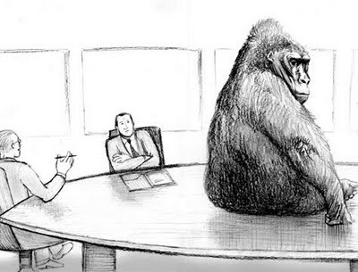
NPC & VA
A knotted relationship?
Boss vs. subordinate
Parent vs. child
My way or the highway
Or, a mix of all

Slide 23
Life under a looming shadow of the great
Advantages and limitations
The BOD and the VA officials
Navigating a large ship
Creating an independent image of NPC

Slide 24
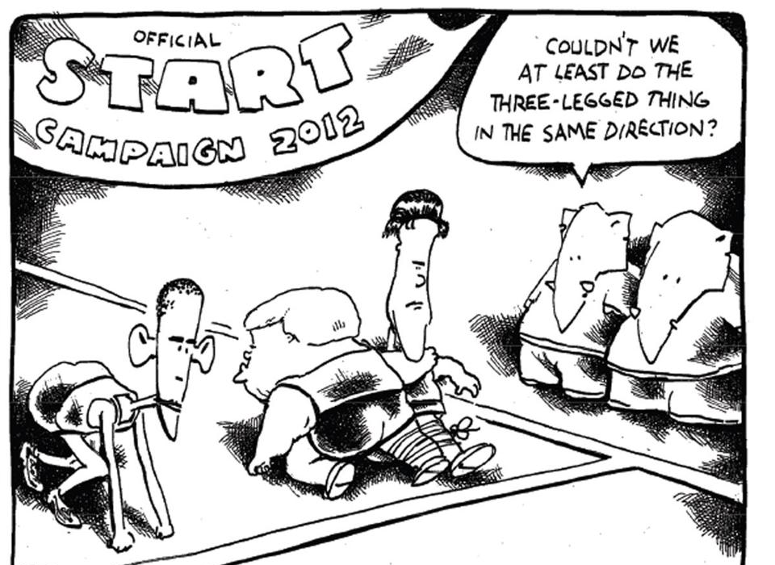
GLOBAL RACE IN RESEARCH
COULDN’T WE AT LEAST DO THE THREE LEGGED THING
IN THE SAME DIRECTION?

Slide 25
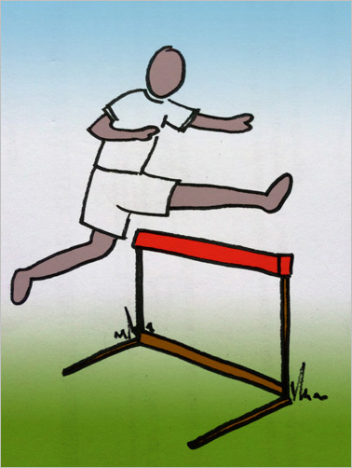
Above all, researchers are a unique breed
Responsible for lasting meaningful changes
Proud, strong and (mostly) quiet
Underappreciated- ignored until crisis hits
Motivated, low profile risk takers
Handle failure more gracefully
Committed to run long hurdles races

