Slide 1
CUI MARKING 101
Notes:
*ISOO is the Executive Agent for the Program
Stress this is for the unclassified environment.
*Markings are outlined in Agencies were involved
***Program came about from the E.O. 13556
**ME: Lead for training and awareness for CUI Program
*What will you get out of this course?

Slide 2
CUI Program Office
Greg Pannoni
Associate Director
Devin Casey
Lead for Program Implementation
Charlene Wallace
Lead for Agency Training and Awareness
Evan Coren
Program Analyst

Slide 3
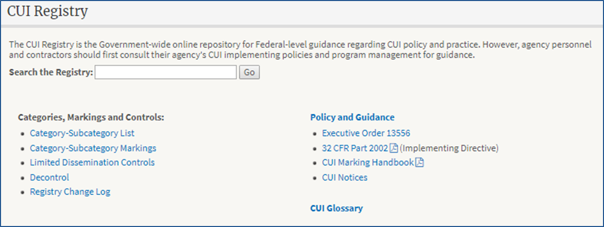
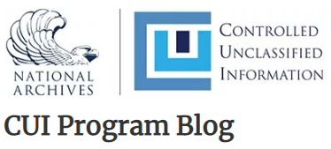
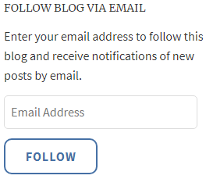
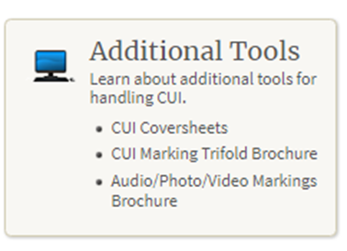
Controlled Unclassified Information (CUI)
What is the CUI Program? The CUI Program is an information security reform that standardizes the way the executive branch handles information that requires protection What is CUI? Controlled Unclassified Information (CUI) is information that requires safeguarding or dissemination controls pursuant to and consistent with applicable laws, regulations, and government-wide policies. | Policy and Guidance Executive Order 13556 32 CFR Part 2002 (Implementing Directive) CUI Marking Handbook CUI Notices CUI Notice 2020-01 (CUI Implementation Deadlines) CUI Notice 2020-02 (Alternate Marking Methods) NIST Publications OMB Circular No. A-11 CUI Advisory Council
www.archives.gov/cui | https://isoo.blogs.archives.gov/
Quarterly CUI Program Updates!
Contact Us! Contact an Agency!

Slide 4
AGENDA
We will address:
Purpose of markings, some of the basic elements of marking, specific markings focusing on paper markings, electronic items and miscellaneous marking
How to mark (emails, spreadsheets, databases, etc.), how to portion mark and supplemental administrative markings
Notes:
**if you have a question on a specific slide, please ask
**if you can wait until the break you can ask then
***You will leave here confident with why you mark CUI and how to mark CUI

Slide 5
Why Mark CUI?
We mark to inform users or recipients that information is CUI and to alert them of any dissemination or safeguarding requirements
Notes:
**WE mark to let the recipient know this information needs to be protected
**CUI and worthy of protection
**explain why we protect (because we need to streamline the markings for CUI)
Groovy thing to say “ Marking is the first safeguard”

Slide 6
CUI includes, but is not limited to:
Financial
Intelligence
Privilege
Unclassified Nuclear
Procurement and Acquisition
Privacy (including Health)
Tax
Law Enforcement
Critical Infrastructure
Export Control
Notes:
what is specified (TAX, health, and privacy).

Slide 7
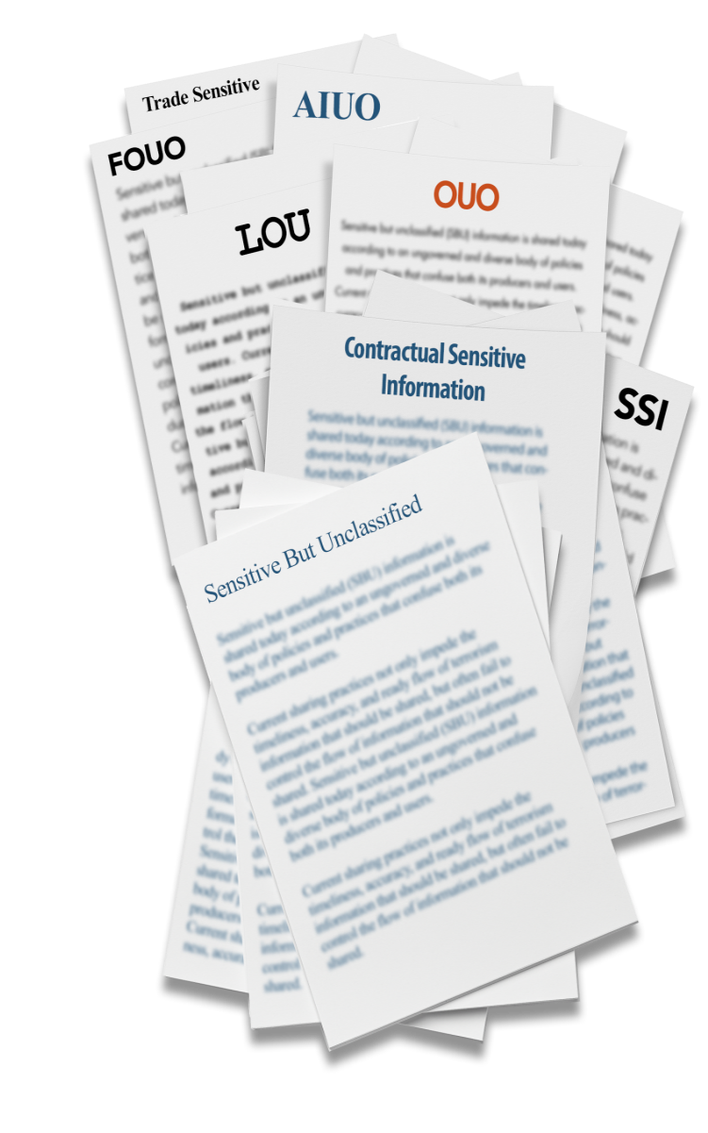
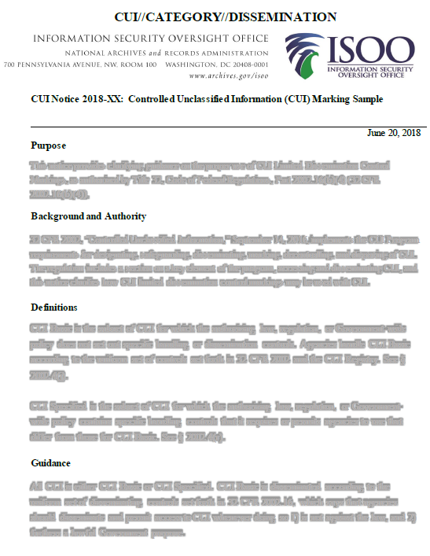
Legacy Information and Markings
All legacy information is not automatically CUI. Agencies must determine what legacy information qualifies as CUI
Notes:
*Information that the agency was protecting prior to the program
**the agency must determine what legacy information qualifies as CUI
*it is likely marked due to sensitivity to the agency
*blend both 6 and 7 together
*most agencies have established a Legacy marking waiver (and what that means is and go to slide 7)

Slide 8
Waivers For Legacy Information
It is information marked prior to the CUI program
Many agencies are pursuing a Legacy information waiver
Waiver states: you do not have to remark the information unless you reuse or transmit it outside of the agency
Consult your Agency policy
When transmitting or transferring legacy information, the marking/identification requirement can be satisfied by using a cover sheet/transmittal document or an indicator in an email
Notes:
***there are 3 kinds of waivers: Legacy waiver (do not have to remark information that was marked PRIOR to the CUI program), Exigent circumstances waiver, limited marking waiver (excessively burdensome while the CUI remains within the agency’s control)
***we are going to talk about legacy marking waivers
***Some agencies have established waivers for legacy information that basically state that you do not need to remark this information unless you reuse of send out side your agency
***

Slide 9
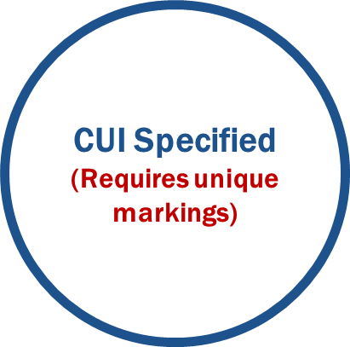
CUI Basic and CUI Specified
Notes:
***start with BASIC then SPECIFIED
**Before Marking CUI, it is important to understand that there are two types of CUI,
**CUI Specified is sensitive information for which laws, regulations and Government-wide polices – or authorities - call for specific protections.
***For CUI Basic the authorities do not.
***CUI Specified must be marked in a different way.
*some kind of reason why you are protecting

Slide 10
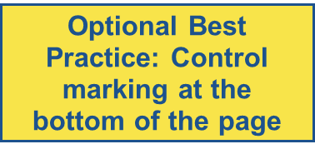
CUI Banner Marking Breakdown
CUI Control Marking
CUI Category Marking (if required)
Limited Dissemination Control Marking
CUI OR CONTROLLED//CATEGORY//DISSEMINATION
The Banner Marking should be easily distinguishable and readily apparent
(bold, capitalized and centered when feasible)
Notes:
***ALWAYS STATE CUI NOT CONTROLLED
Banner marking is mandatory. Three elements to the banner. Control marking always required.

Slide 11
CUI Control Marking
MANDATORY:
CUI Banner Markings must appear on the top portion of the page
The Banner Marking should be easily distinguishable and readily apparent
(bold, capitalized and centered when feasible)
You have the choice of using
CUI
or the word
CONTROLLED
All that is required for CUI Basic
Notes:
***hit 2 forward slashes between
Always required. All that is required for Basic. You do not have to list basic category markings in the banner, unless you agency policy says to.

Slide 12
CUI Category Marking
The CUI Category Marking is separated from the Control Marking by a double forward slash.
When including multiple Category Markings they should be separated by a single forward slash
and in alphabetical order
Notes:
**Only the markings that are listed on the CUI Registry may be used
***Required for CUI Specified Categories
***MUST be alphabetized and separated from other categories with a single forward slash
***CUI Specified Categories appear before basic ones***

Slide 13
CUI Limited Dissemination Controls
CUI Limited Dissemination Control markings follow the Category marking and are separated from the other elements by double forward slash.
When including multiple Category Markings they should be separated by a single forward slash
When a document contain multiple Limited Dissemination Control Markings, those Limited Dissemination Control markings MUST be alphabetized and separated from each other with a single forward slash
Notes:
*** this is OPTIONAL and talk about when to use it (when information should be seen by certain people)
*can use them to inform the user of any dissemination requirement found in the LRGWP
***export control (should not be used or given to No foreign nationals
*the agency in their policy or procedure should have some3 details about the categories that they should handle
**
- Not required. If used, should reflect dissemination requirements found in LRGWP. Only 7 and found on the CUI Registry

Slide 14
Alternative Markings
When it is impractical for an agency to individually mark CUI due to quantity or nature of the information, or when an agency has issued a limited CUI marking waiver, authorized holders must make recipients aware of the information's CUI status using an alternate marking method that is readily apparent (for example, through user access agreements, a computer system digital splash screen (e.g., alerts that flash up when accessing the system), or signs in storage areas or on containers)
Marking in the physical environments (boxes, inventories)
Notes:
*ties into next slide ***go back and fourth to the next slide
*quantity of the information
*to satisfy the marking
****think bulk marking*****
Don’t forget about the coversheet!

Slide 15
System Markings
Agencies may authorize or require the use of alternate CUI indicators on IT systems, websites, browsers, or databases through agency CUI policy. These may be used to alert users of the presence of CUI where use of markings has been waived by the agency head.
Notes:
***both alternative marking
-system banner markings, pop up windows, or user agreements, and training

Slide 16
Designation Indicator
All documents containing CUI MUST (hard requirement) indicate the agency of designation - This may come in several forms, including a letterhead, signature block, or “controlled by line”
A best practice is also to include the contact information of the designating agency, and identify a point of contact or division within the organization
On an email it would be: @nara.gov
Designating
Agency Indicator
Department of Good Works
Washington, D.C. 20006
June 27, 2013
MEMORANDUM FOR THE DIRECTOR
From: John E. Doe, Chief Division 5
Subject: Examples
We support the President by ensuring that the Government protects and provides proper access to information to advance the national and public interest.
We lead efforts to standardize and assess the management of classified and controlled unclassified information through oversight, policy development, guidance, education, and reporting.
CUI
Contact Info
All questions can be directed to the Security and Inspection Division, 123-456-7890
CUI
Notes:
*just say who generated the CUI, letterhead, email address
*gives recipient a way to see
*before the CUI program ()
****accountability
***This is the answer to What is this: it is something that says who (individual or agency) generated the CUI

Slide 17
CUI Registry
https://www.archives.gov/cui/registry/category-marking-list
Notes:
Add notes from Mark
***point out below the marking
***add something with the authorities information
***your agency should explain to you the “why” it is specified
***the registry is there for a resource but should not be given to the employee to use

Slide 18
CUI Registry
https://www.archives.gov/cui/registry/category-marking-list
Notes:
Add notes from Mark
***point out below the marking
***add something with the authorities information
***your agency should explain to you the “why” it is specified
***the registry is there for a resource but should not be given to the employee to use

Slide 19
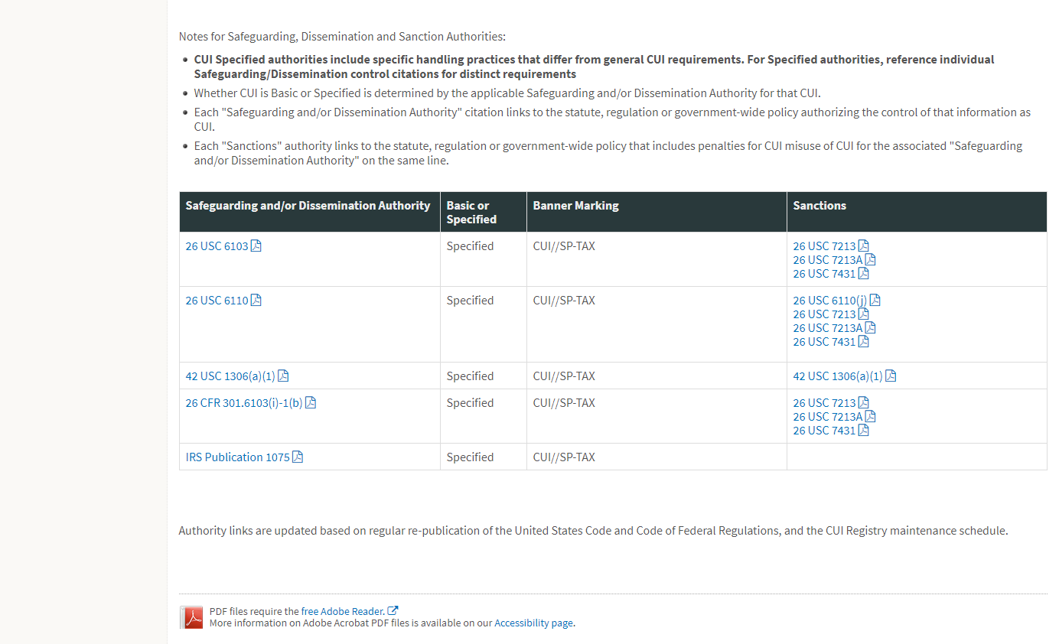
CUI Registry
https://www.archives.gov/cui/registry/category-marking-list
Notes:
Add notes from Mark
***point out below the marking
***add something with the authorities information
***your agency should explain to you the “why” it is specified
***the registry is there for a resource but should not be given to the employee to use

Slide 20
What have we learned so far
We learned:
why we mark CUI
the two kinds of CUI (Basic and Specified)
about Legacy information
about Waivers for Legacy information
about System markings
what a Designation Indicator is and why its important
the different parts to the CUI Banner Marking
Notes:
**Does anyone have any questions?

Slide 21
Marking CUI Basic
CUI
Department of Good Works
Washington, D.C. 20006
June 27, 2013
MEMORANDUM FOR THE DIRECTOR
From: John E. Doe, Chief Division 5
Subject: Examples
We support the President by ensuring that the Government protects and provides proper access to information to advance the national and public interest.
We lead efforts to standardize and assess the management of classified and controlled unclassified information through oversight, policy development, guidance, education, and reporting.
For CUI basic the Laws, Regulations, or Government-wide policies DO NOT require specific protections.
Category markings are optional unless required by Agency policy
Notes:
Control marking is enough!
Why would one want to add a basic category marking to the banner?

Slide 22
Mandatory CUI Banner Marking
Department of Good Works
Washington, D.C. 20006
June 27, 2013
MEMORANDUM FOR THE DIRECTOR
From: John E. Doe, Chief Division 5
Subject: Examples
We support the President by ensuring that the Government protects and provides proper access to information to advance the national and public interest.
We lead efforts to standardize and assess the management of classified and controlled unclassified information through oversight, policy development, guidance, education, and reporting.
It is MANDATORY to include a banner marking at the top of the page denoting Controlled Unclassified Information
Optional, best practice is to include on bottom as well, it MUST be identical to the top
CUI
CUI
Footer markings are optional
Notes:
****revisit that it should be BOLD, and centered
***will use CUI and not so much CONTROLLED
***readily apparent
*****don’t need a marking tool to mark CUI

Slide 23
Marking CUI Specified
CUI//SP-PRVCY
Department of Good Works
Washington, D.C. 20006
June 27, 2013
MEMORANDUM FOR THE DIRECTOR
From: John E. Doe, Chief Division 5
Subject: Examples
We support the President by ensuring that the Government protects and provides proper access to information to advance the national and public interest.
We lead efforts to standardize and assess the management of classified and controlled unclassified information through oversight, policy development, guidance, education, and reporting.
SP-PRVCY denotes Privacy Information- specified CUI that is handled with unique controls
Since CUI Specified can call for different controls and protection than CUI Basic, it is mandatory to label it in a banner (SP-)
All categories relating to specified information MUST have SP- precede the category marking
Notes:
***mention CUI Registry here (again)

Slide 24
CUI Specified Category marking
CUI Category marking are separated by a double forward slash (//) from the CUI Control Marking - If there are multiple CUI Category markings in the banner they must be separated by a single forward slash (/)
CUI//SP-CRIT
Department of Good Works
Washington, D.C. 20006
June 27, 2013
MEMORANDUM FOR THE DIRECTOR
From: John E. Doe, Chief Division 5
Subject: Examples
We support the President by ensuring that the Government protects and provides proper access to information to advance the national and public interest.
We lead efforts to standardize and assess the management of classified and controlled unclassified information through oversight, policy development, guidance, education, and reporting.
Note that in the example provided: - The mandatory CUI marking is present - The category, critical infrastructure (CRIT), falls after two forward slashes (//)
Notes:
**required for Specified
**

Slide 25
When to use Limited Dissemination Controls
Use them to highlight requirements found in the underlying laws, regulations, or government wide policies,
Agency dissemination practices
Cautionary note: The misapplication of them could negatively impact the dissemination of CUI
Notes:
***when you want to share the information with specific individuals or exclude specific individuals
****DL ONLY list,

Slide 26
Limited Dissemination Controls
Limited Dissemination Controls are not mandatory
Limited Dissemination Controls Markings are separated from other elements of the banner by two forward slashes (//)
When a document contains multiple Limited Dissemination Control Markings, those Limited Dissemination Control Markings separated by a single slash (/)
CUI//SP-XXX//NOFORN
Department of Good Works
Washington, D.C. 20006
June 27, 2013
MEMORANDUM FOR THE DIRECTOR
From: John E. Doe, Chief Division 5
Subject: Examples
We support the President by ensuring that the Government protects and provides proper access to information to advance the national and public interest.
We lead efforts to standardize and assess the management of classified and controlled unclassified information through oversight, policy development, guidance, education, and reporting.
We lead efforts to standardize and assess the management of classified and controlled unclassified information through oversight, policy development, guidance, education, and reporting.
In this example, the specified category is indicated by SP-XXX, and the “No Foreign dissemination” control is used.
Notes:
***share w/ specific people or groups

Slide 27
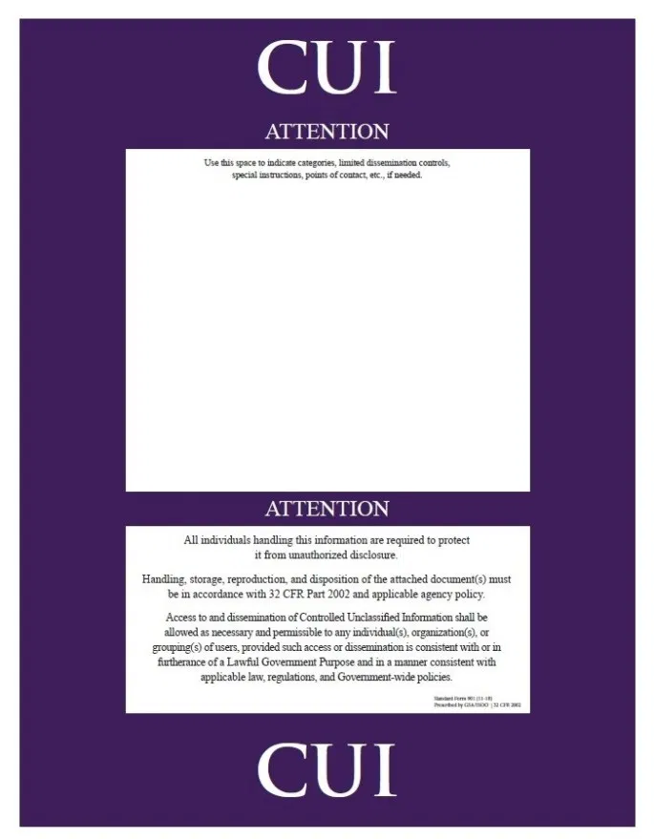
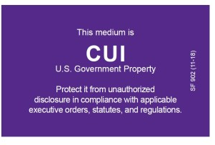
Coversheet and CUI Media Labels
Standard Form 901:
Detailed Coversheet
Coversheets are optional, but can replace Banner Markings
It can also include categories/dissemination controls or list/originator designation
Download from the CUI Registry at: www.archives.gov/cui/additional-tools
Notes:
***tool that agencies use to mark CUI
**can be done not have to be done
****can not use your agency
***fillable PDF
***where you can find them
***GSA advantage

Slide 28
Use of Coversheets while teleworking
Reminder:
when using an SF 901 (CUI Coversheet) you can be print it out Purple or black and white
4 Coversheets
2 Purple
2
Black & White
Notes:
***tool that agencies use to mark CUI
**can be done not have to be done
****can not use your agency
***fillable PDF
***where you can find them
***GSA advantage

Slide 29
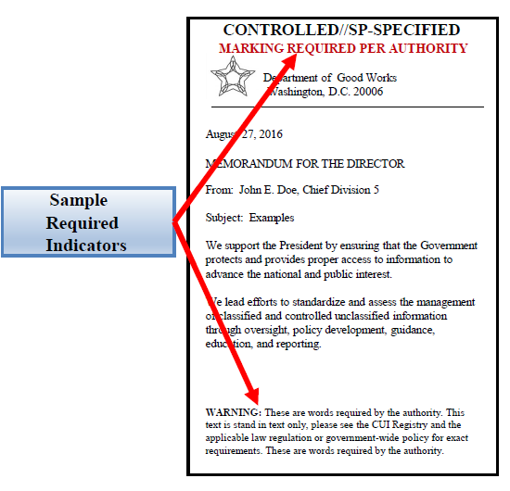
Markings per Authorities
Certain categories
of CUI require additional markings/indicators that are called for in the LRGWP
See your Agency policy
Notes:
***particular statements that need to be placed on the documents BY LRGWP (GOES UNDER THE CUI MARKING)
***can NOT be comingled in the CUI Marking

Slide 30
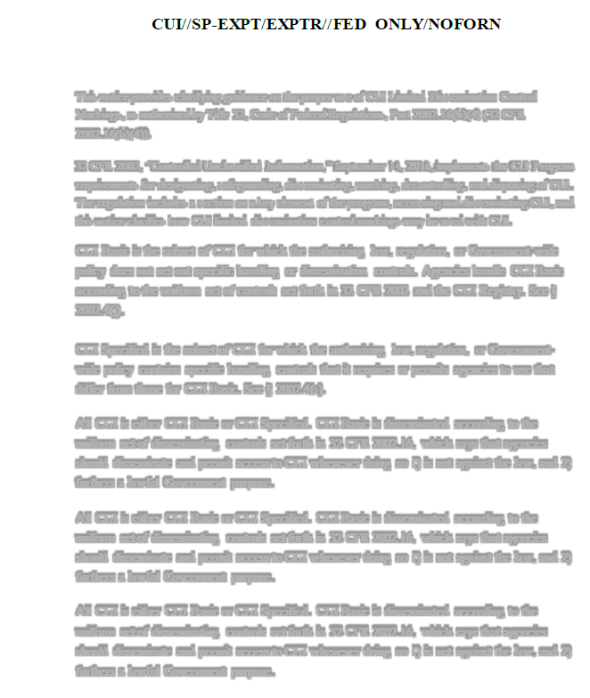
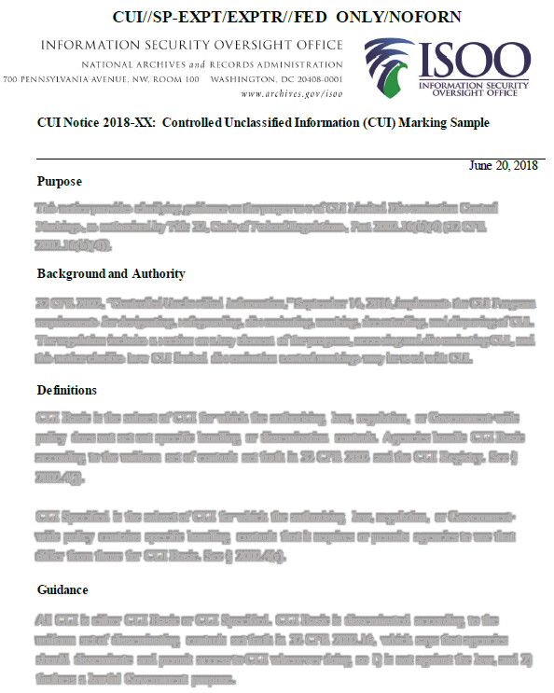
Marking Multiple Pages
The make up of the CUI Banner for a multi-page document is essentially the sum of all of the CUI markings in the document; include all specified category markings and any limited dissemination control markings used throughout the document in the banner
3
2
1
Notes:
***on a bond book (put a coversheet on the first page) (IF THIS COMES UP)
****

Slide 31
What have we learned so far
We learned:
how and when to use a CUI Coversheet
what a Banner Marking looks like
about marking per authorities
how to mark multiple pages
what a Category Marking is and how to use it
what CUI Specified marking is and how to use it
what CUI Basic marking is and how to use it
when to use Limited Dissemination Controls
Notes:
TP for markings per authorities. As agencies implement the program, we expect that those with regulatory authority will modify regulations to include CUI markings. (if needed).

Slide 32
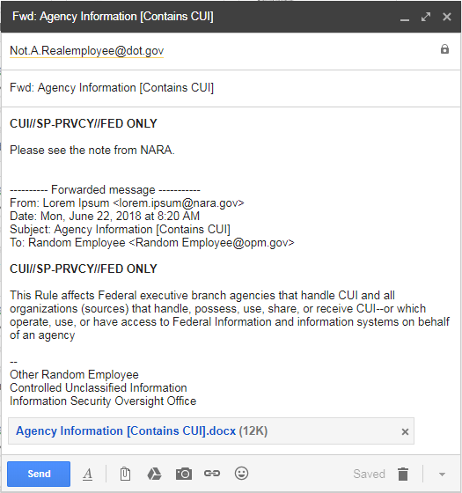
Marking Emails
When marking emails it is mandatory to include a Banner Marking to indicate that the email contains CUI
It is best practice to include an Indicator Marking in the subject line
If the email is forwarded, the Banner Marking must be carried forward
If sending an attachment that contains CUI, the name of the file can contain a CUI indicator
Optional Subject Line Indicator Marking
Mandatory Banner Marking
Optional Attachment Indicator Marking
Notes:
Marking CUI in Email follows the same principles for marking CUI in other contexts:
Banner Markings must appear above the email text containing CUI;
As a best practice, the Subject Line may also indicate the email contains CUI.
File Names for any attachments containing CUI, may also include an indicator that alerts the recipient to the presence of CUI.
Be sure to include all applicable markings when forwarding or responding to emails that contain CUI.
***same principles as document markings
***include marking only if CUI is contained in reply. What should the marking be/could be if no CUI is present

Slide 33
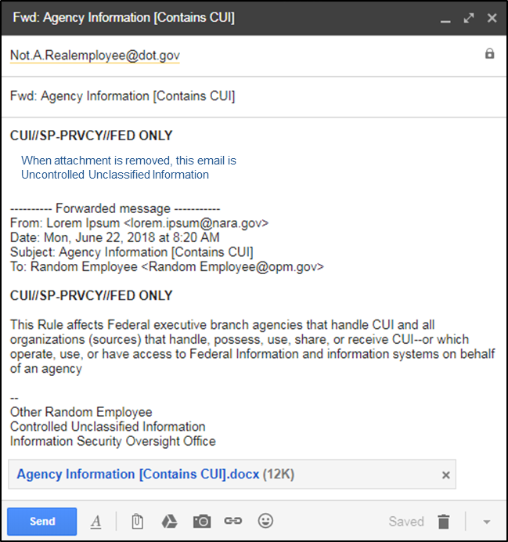
Marking emails cont.
When sending an email where the attachment is removed and the email no longer contains CUI, add the following statement below the banner marking:
“When attachment is removed, this email is Uncontrolled Unclassified Information”
Indicators in the subject line and attachments should appear at the end
Reminder: When sending an email that contains CUI, it must be encrypted

Slide 34
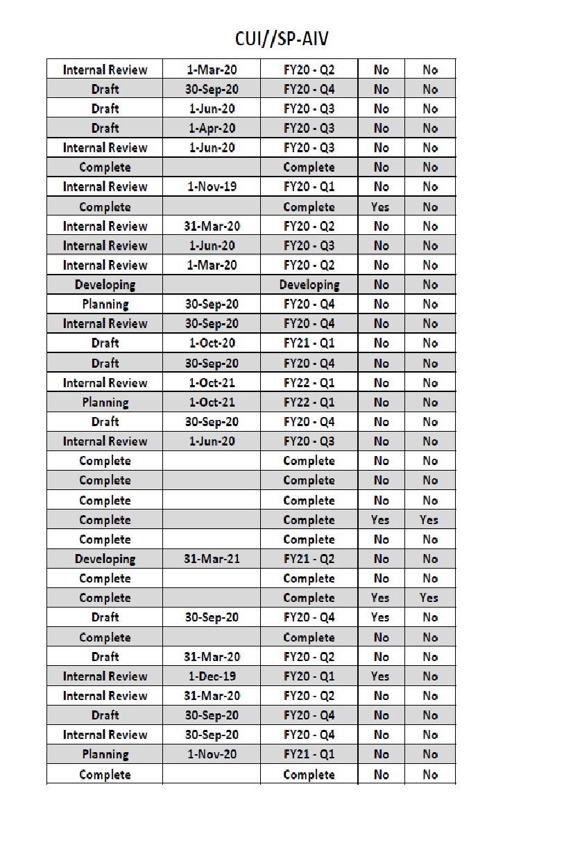
How do you mark or identify CUI in spreadsheets
If you are working in the spreadsheet you need to modify the header and/or footer
Here are some ways:
Header
filename indicator
(ex: contains CUI)
Coversheet (after printing)
Controlled by: Alan G. DOGW
Notes:
***files do not have to indicate the presence of CUI

Slide 35
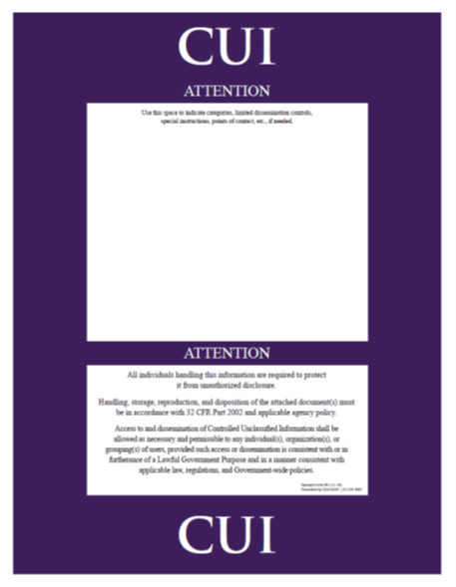
How do you mark or identify CUI in PowerPoints
Here are some ways:
Apply banner marking
Filename indicator
(ex: contains CUI)
Coversheet

Slide 36
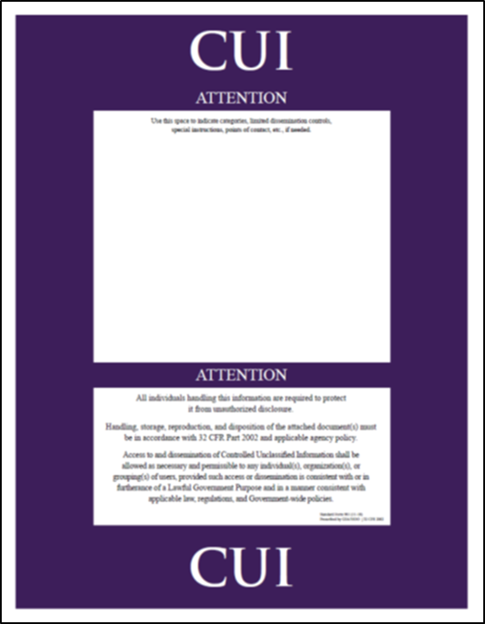
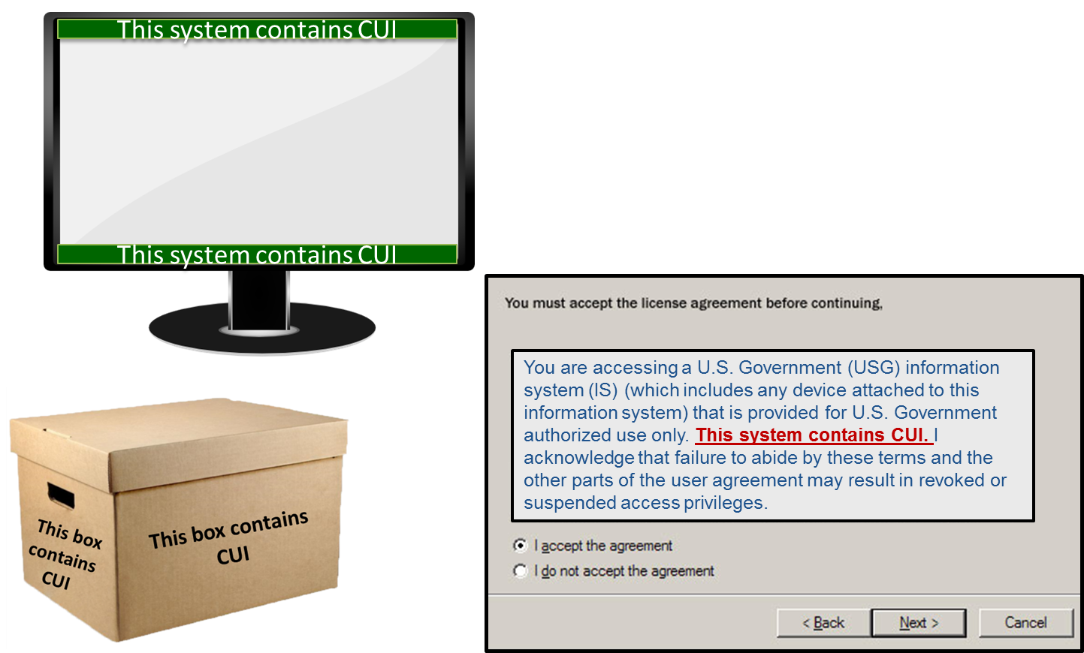
How do you mark or identify CUI in databases or application
Here are some ways:
Apply banner marking to outputs when printing
filename indicator (ex: contains CUI)
Coversheet (upon printing)
Splash screen (upon log in or initial access to system)
Individual pages can carry a banner marking to indicate CUI is present
Notes:
When printing out the cover sheet, you may print it out in black and white

Slide 37
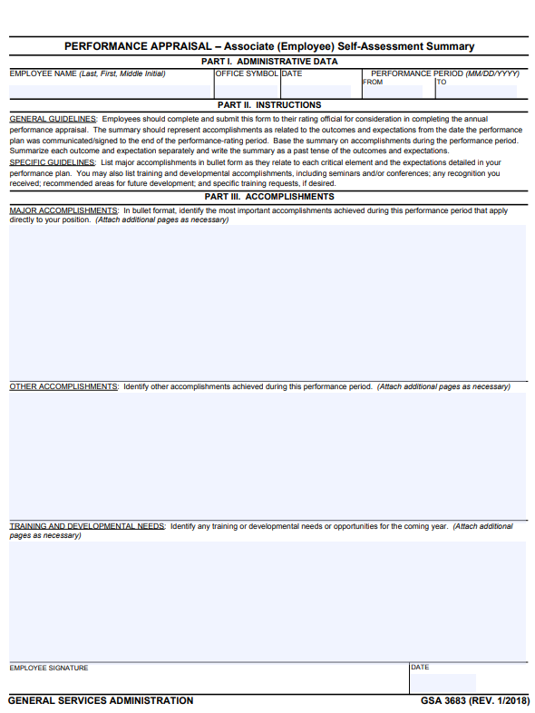
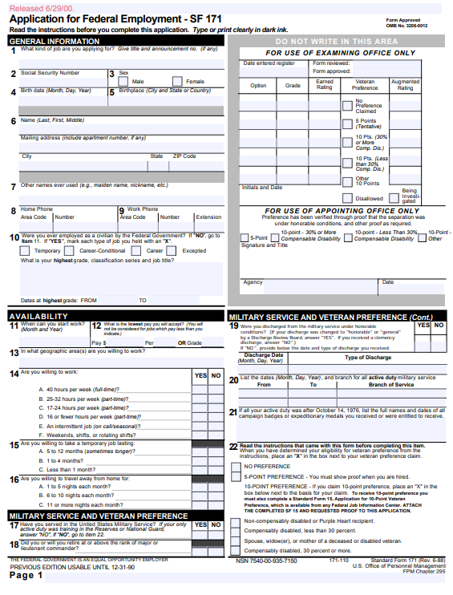
Marking Forms
Forms that, when filled in, contain CUI, must be marked accordingly
You may use a coversheet if there is not room at the top of the form
CUI//SP-PERS
when filled in
Mandatory CUI Control
Marking
Notes:
***Use the IRS example

Slide 38
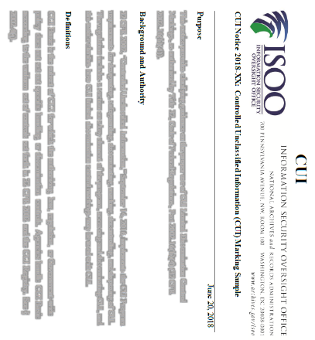
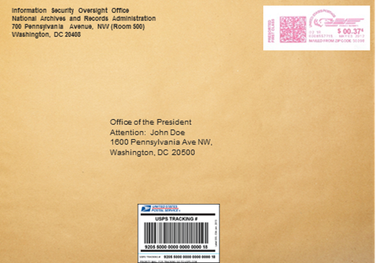
Shipping and Mailing
CUI may be shipped
Best practice is to track the package
DO NOT
CONTROLLED
Place Markings on Packages/Envelopes
CONTROLLED
Notes:
When shipping CUI, you may use interagency mail systems, the United States Postal Service, or any commercial delivery service.
As a best practice, use in-transit automated tracking to record the progress of your shipment from departure to arrival.
And remember: the contents of packages must be appropriately marked, but do not place markings on the outside of packages or envelops.

Slide 39
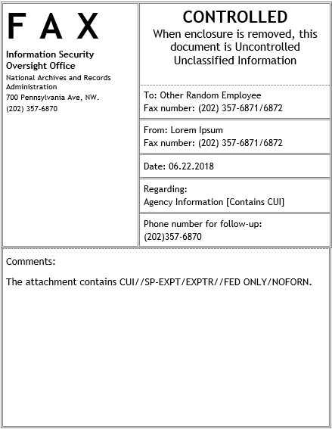
Marking Transmittal Documents
Mandatory Transmittal Message
If a transmittal document accompanies CUI, it must indicate that CUI is attached and include
“When enclosure is removed, this document is Uncontrolled Unclassified Information” or
“When enclosure is removed, this document is (CUI Category); upon removal, this document does not contain CUI”
Mandatory Message that CUI is Present

Slide 40
Portion Markings
Though not required, portion marking is a highly encouraged practice
CUI Portion Markings are placed at the beginning of the portion to which they apply and must be used throughout the entire document
When marking CUI, if a portion of the document does not contain CUI it can be denoted as Uncontrolled (U)
CUI
Department of Good Works
Washington, D.C. 20006
June 27, 2013
MEMORANDUM FOR THE DIRECTOR
From: John E. Doe, Chief Division 5
Subject: (U) Examples
(U) We support the President by ensuring that the Government protects and provides proper access to information to advance the national and public interest.
(CUI) We lead efforts to standardize and assess the management of classified and controlled unclassified information through oversight, policy development, guidance, education, and reporting.
Portion
Markings

Slide 41
Supplemental Administrative Marking
Supplemental Agency Markings can be used to denote non-final status of a document
Cannot be used to control CUI and cannot be commingled into the CUI Banner Marking
Department of Good Works
Washington, D.C. 20006
June 27, 2013
MEMORANDUM FOR THE DIRECTOR
From: John E. Doe, Chief Division 5
Subject: Examples
We support the President by ensuring that the Government protects and provides proper access to information to advance the national and public interest.
We lead efforts to standardize and assess the management of classified and controlled unclassified information through oversight, policy development, guidance, education, and reporting.
CUI
DRAFT
CUI Banner
Marking
Administrative Indicator
Notes:
TP: Agencies must detail requirements for using supplemental administrative markings with CUI in agency policy that is available to anyone who may come into possession of CUI with these markings. Just a note that this is a must

Slide 42
QUESTION #1
What are the 2 kinds of CUI?
Sensitive and Unsensitive
Basic and Specified
Classified and Unclassified

Slide 43
ANSWER: B CUI Basic and CUI Specified
CUI Specified
(Requires unique markings)
Laws, Regulations, or Government-wide policies require specific protections. For example:
Unique markings
Enhanced physical safeguards
Limits on who can access the information
CUI Basic
Laws, Regulations, or Government-wide policies DO NOT require specific protections
Notes:
ANSWER: B
Basic And Specified

Slide 44
QUESTION #2
True or False:
Your Agency does NOT have to alert the user of the presence of CUI when logging into IT systems, websites, browsers, or databases

Slide 45
ANSWER: TRUE System Markings
Agencies may authorize or require the use of alternate CUI indicators on IT systems, websites, browsers, or databases through agency CUI policy. These may be used to alert users of the presence of CUI where use of markings has been waived by the agency head.
Notes:
ANSWER: TRUE
It is not a hard requirement. An agency could
As an could employ alternative marking when it’s on it’s network, databases and drives

Slide 46
QUESTION #3
True or False:
It is MANDATORY to include a banner marking at the top of the page to alert the user that CUI is present?
Notes:
*** people read from top to bottom
****your attention will be brought the top of the page

Slide 47
ANSWER: TRUE CUI Banner Marking
MANDATORY:
CUI Banner Markings must appear on the top portion of the page
Notes:
ANSWER: TRUE

Slide 48
QUESTION #4
TRUE OR FALSE:
When sending an email that contains CUI you must include an indicator marking in the subject line
Notes:
*it is mandatory to include a banner marking on an email when it contains CUI
*MAKE TRUE FALSE
WHEN SENDING AN EMAIL IT IS MANDATORY TO INCLUDE ABANNER MARKING AS THE FIRST LINE OF TEXT

Slide 49
Answer: FALSE Marking Emails
When marking emails it is mandatory to include a Banner Marking to indicate that the email contains CUI
It is best practice to include an Indicator Marking in the subject line
If the email is forwarded, the Banner Marking must be carried forward
If sending an attachment that contains CUI, the name of the file can contain a CUI indicator
Optional Subject Line Indicator Marking
Mandatory Banner Marking
Optional Attachment Indicator Marking
Notes:
ANSWER: false
Banner marking and optional Indicator Marking in the subject line
You should also use and indicator and it MUST be encrypted

Slide 50
QUESTION #5
True or False:
You can ONLY use FedEx or UPS to mail CUI

Slide 51
Answer: FALSE Shipping and Mailing
CUI may be shipped
Best practice is to track the package
DO NOT
CONTROLLED
Place Markings on Packages/Envelopes
CONTROLLED
Notes:
ANSWER: FALSE
You may use any form of mailing as long as you do NOT put CUI Markings on the outside of the item
High recommend use in transit tracking

Slide 52
QUESTION #6
True or False:
Below is an accurate example of how to use Supplemental Administrative Markings:
CUI//SP-DRAFT

Slide 53
Supplemental Administrative Marking
Supplemental Agency Markings can be used to denote non-final status of a document
Cannot be used to control CUI and cannot be commingled into the CUI Banner Marking
Answer:
FALSE
Department of Good Works
Washington, D.C. 20006
June 27, 2013
MEMORANDUM FOR THE DIRECTOR
From: John E. Doe, Chief Division 5
Subject: Examples
We support the President by ensuring that the Government protects and provides proper access to information to advance the national and public interest.
We lead efforts to standardize and assess the management of classified and controlled unclassified information through oversight, policy development, guidance, education, and reporting.
CUI
DRAFT
CUI Banner
Marking
Administrative Indicator
Notes:
ANSWER: False

Slide 54
QUESTION #7
Yes or No:
Can you use the CUI Coversheet in lieu of marking a document?

Slide 55
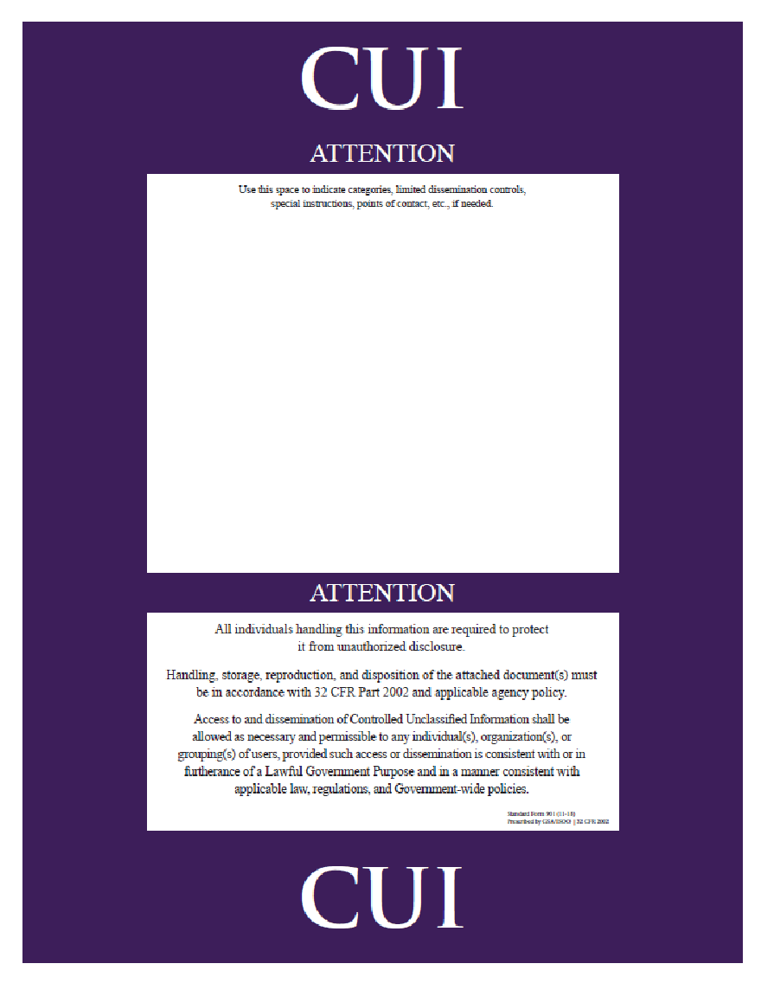
Answer: YES Coversheet
Standard Form 901:
Detailed Coversheet
Coversheets are optional, and can replace Banner Markings
It can also include categories/dissemination controls or list/originator designation
Download from the CUI Registry at: www.archives.gov/cui/additional-tools
Notes:
Answer: YES, the coversheet is an acceptable alternative to a banner marking.

Slide 56
Information Security Oversight Office
Attn: CUI Program
National Archives and Records Administration
700 Pennsylvania Avenue, N.W., Room 100
Washington, DC 20408-0001
CUI@NARA.GOV

